Slide 1
Application: The Costs of Taxation
CHAPTER 8
Notes:
N. Gregory Mankiw Principles Of Economics Eight Edition

Slide 2
Deadweight Loss of Taxation, Part 1
Tax on a good levied on buyers
Demand curve shifts downward
By the size of tax
Tax on a good levied on sellers
Supply curve shifts upward
By the size of tax

Slide 3
Deadweight Loss of Taxation, Part 2
Tax on a good levied on buyers or on sellers
Same outcome: a price wedge
Price paid by buyers rises
Price received by sellers falls
Lower quantity sold

Slide 4
Deadweight Loss of Taxation, Part 3
Tax burden
Distributed between producers and consumers
Determined by elasticities of supply and demand
Market for the good
Smaller

Slide 5
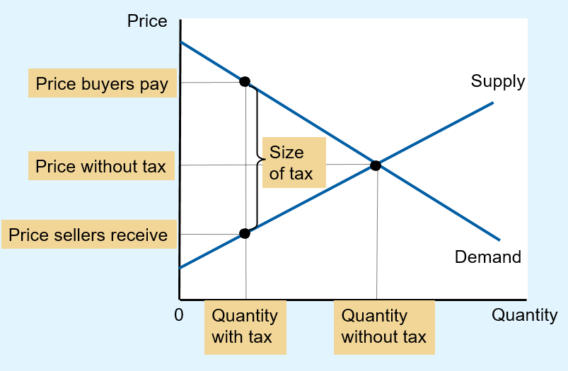
Figure 1 The Effects of a Tax
A tax on a good places a wedge between the price that buyers pay and the price that sellers receive.
The quantity of the good sold falls.

Slide 6

Deadweight Loss of Taxation, Part 4
Economic welfare
Buyers: consumer surplus
Sellers: producer surplus
Government: total tax revenue
Tax times quantity sold
Public benefit from the tax
“You know, the idea of taxation with representation doesn’t appeal to me very much, either.”

Slide 7
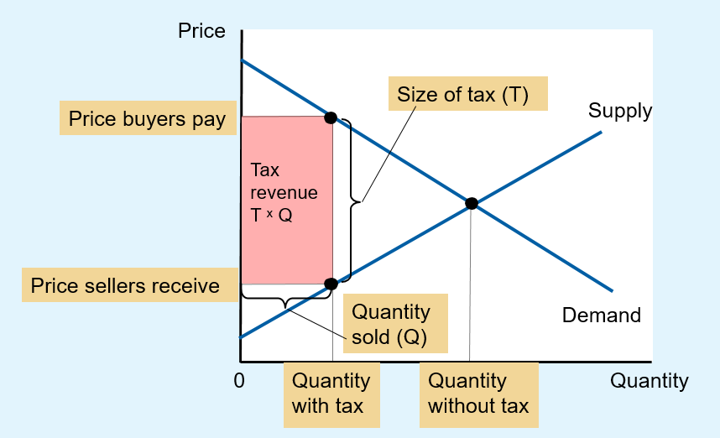
Figure 2 Tax Revenue
The tax revenue that the government collects equals T × Q, the size of the tax T times the quantity sold Q. Thus, tax revenue equals the area of the rectangle between the supply and demand curves.

Slide 8
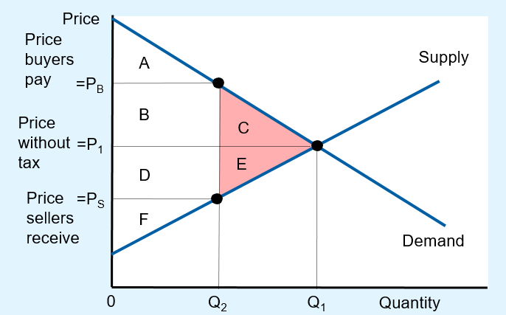
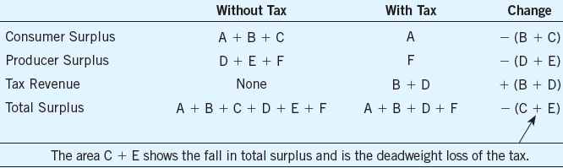
Figure 3 How a Tax Affects Welfare
A tax on a good reduces consumer surplus (by the area B + C) and producer surplus (by the area D + E).
Because the fall in producer and consumer surplus exceeds tax revenue (area B + D), the tax is said to impose a deadweight loss (area C + E).
Empty Cell | Without Tax | With Tax | Change
Consumer Surplus | A + B + C | A | Negative left parenthesis B + C right parenthesis
Produce Surplus | D + E + F | F | Negative left parenthesis D + E right parenthesis
Tax Revenue | None | B + D | Positive left parenthesis B + D right parenthesis
Total Surplus | A + B + C + D + E + F | A + B + D + F | Negative left parenthesis C + E right parenthesis

Slide 9
Deadweight Loss of Taxation, Part 5
Welfare without a tax
Consumer surplus, areas A, B, and C
Producer surplus, areas D, E, and F
Total tax revenue = 0
Welfare with tax
Smaller consumer surplus, area A
Smaller producer surplus, area F
Total tax revenue, areas B and D
Smaller overall welfare

Slide 10
Deadweight Loss of Taxation, Part 6
Losses of surplus to buyers and sellers, from a tax
Exceed the revenue raised by the government
Deadweight loss
Fall in total surplus that results from a market distortion, such as a tax
Taxes distort incentives
Markets allocate resources inefficiently

Slide 11
Deadweight Loss of Taxation, Part 7
Deadweight losses and gains from trade
Taxes cause deadweight losses
Prevent buyers and sellers from realizing some of the gains from trade
The gains from trade
Difference between buyers’ value and sellers’ cost are less than the tax
Once the tax is imposed some trades are not made: deadweight loss

Slide 12
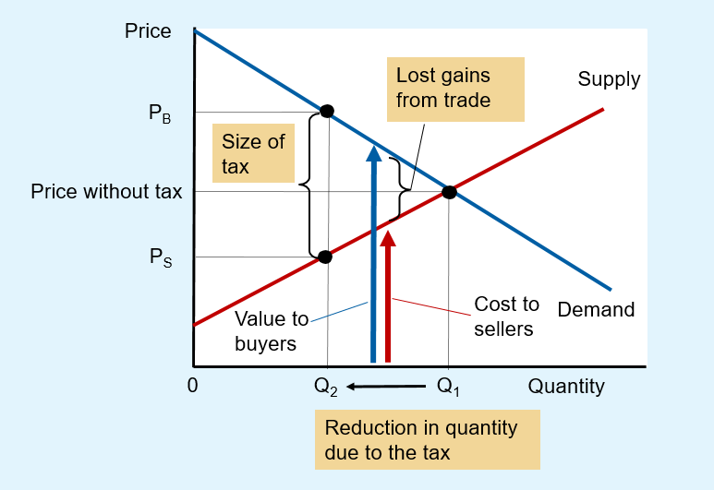
Figure 4 The Source of a Deadweight Loss
When the government imposes a tax on a good, the quantity sold falls from Q₁ to Q₂.
At every quantity between Q₁ and Q₂, the potential gains from trade among buyers and sellers are not realized. These lost gains from trade create the deadweight loss.

Slide 13
Determinants of Deadweight Loss
Price elasticities of supply and demand
More elastic supply curve
Larger deadweight loss
More elastic demand curve
Larger deadweight loss
The greater the elasticities of supply and demand
The greater the deadweight loss of a tax

Slide 14
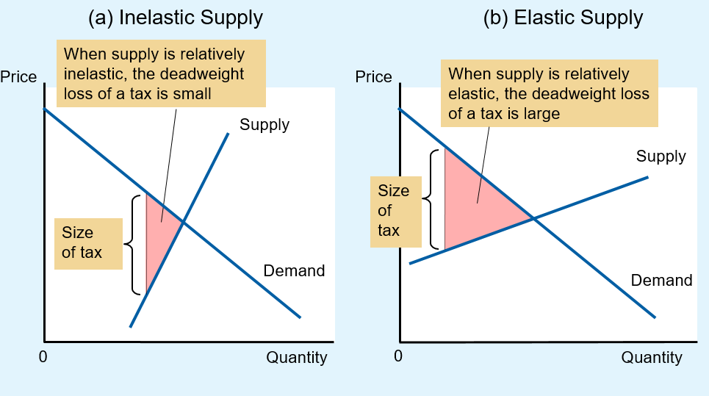
Figure 5 Tax Distortions and Elasticities (a, b)
In panels (a) and (b), the demand curve and the size of the tax are the same, but the price elasticity of supply is different. Notice that the more elastic the supply curve, the larger the deadweight loss of the tax.

Slide 15
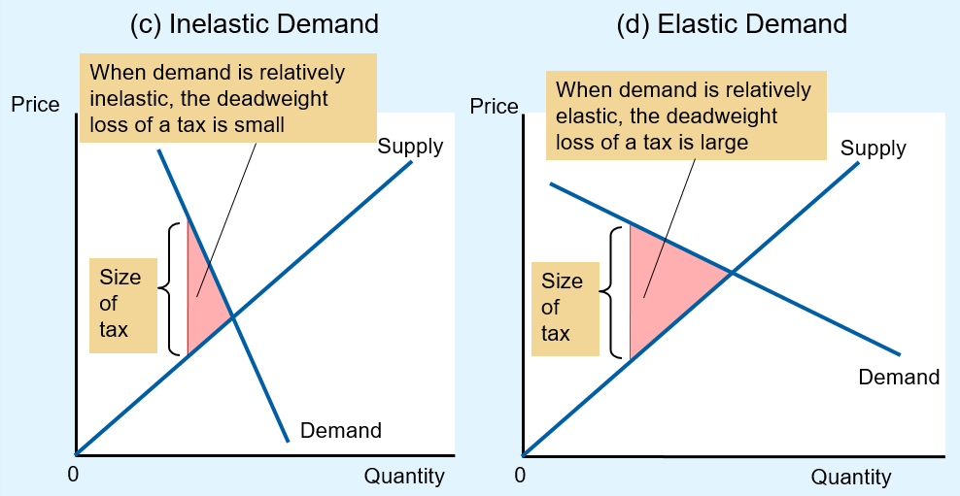
Figure 5 Tax Distortions and Elasticities (c, d)
In panels (c) and (d), the supply curve and the size of the tax are the same, but the price elasticity of demand is different. Notice that the more elastic the demand curve, the larger the deadweight loss of the tax.

Slide 16
The deadweight loss debate, Part 1
How big should the government be?
The larger the deadweight loss of taxation
The larger the cost of any government program
If taxes impose large deadweight losses
These losses are a strong argument for a leaner government that does less and taxes less
If taxes impose small deadweight losses
Government programs are less costly

Slide 17
The deadweight loss debate, Part 2
How big are the deadweight losses of taxation?
Economists disagree
Tax on labor (the labor tax)
Social Security tax, Medicare tax, much of federal income tax
Places a wedge between the wage that firms pay and the wage that workers receive
Marginal tax rate on labor income is 40% (tax rate on the last dollar of earnings)

Slide 18

The deadweight loss debate, Part 3
40% labor tax: Small or large deadweight loss?
Some believe labor supply
is fairly inelastic
Almost vertical
Most people would work full-time regardless of wage
Tax on labor: small deadweight loss
“What’s your position on the elasticity of labor supply?”

Slide 19
The deadweight loss debate, Part 4
Others: labor supply is more elastic
Tax on labor: greater deadweight loss
Many workers can adjust the number of hours they work (overtime)
Some families have second earners; some discretion over whether to do unpaid work at home or paid work in the marketplace
Many of the elderly can choose when to retire
Some people consider engaging in illegal economic activity (underground economy)

Slide 20
Deadweight Loss & Tax Revenue
As the tax increases
Deadweight loss increases
Even more rapidly than the size of the tax
Tax revenue
Increases initially
Then decreases
The higher tax: drastically reduces the size of the market

Slide 21
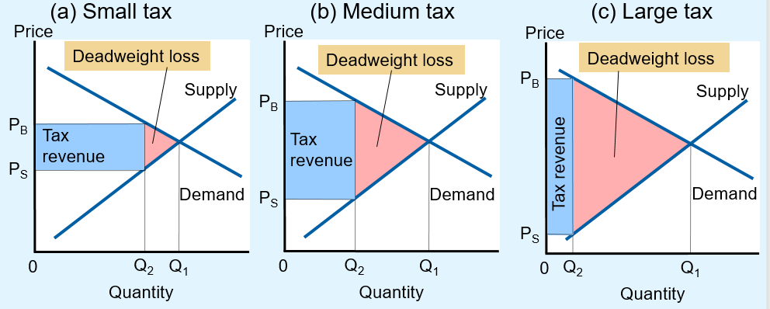
Figure 6 How Deadweight Loss and Tax Revenue Vary with the Size of a Tax (a, b, c)
The deadweight loss is the reduction in total surplus due to the tax. Tax revenue is the amount of the tax multiplied by the amount of the good sold.
In panel (a), a small tax has a small deadweight loss and raises a small amount of revenue.
In panel (b), a somewhat larger tax has a larger deadweight loss and raises a larger amount of revenue.
In panel (c), a very large tax has a very large deadweight loss, but because it has reduced the size of the market so much, the tax raises only a small amount of revenue.

Slide 22
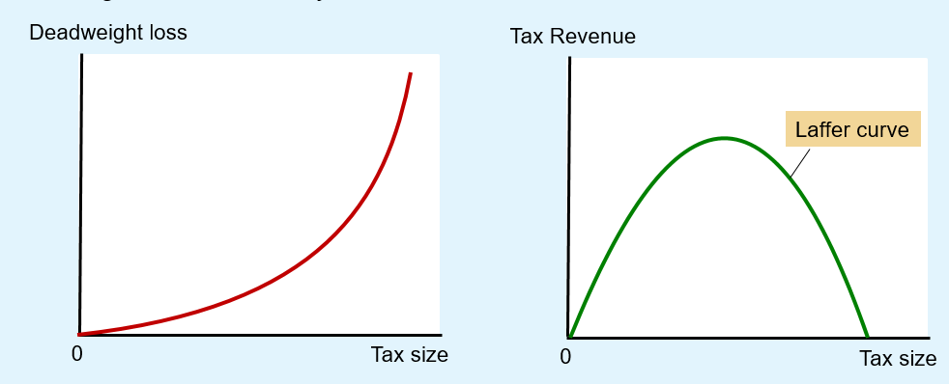
Figure 6 How Deadweight Loss and Tax Revenue Vary with the Size of a Tax (d, e)
(d) From panel (a) to panel (c),
deadweight loss continually increases
(e) From panel (a) to panel (c), tax
revenue first increases, then decreases
Panels (d) and (e) summarize these conclusions.
Panel (d) shows that as the size of a tax grows larger, the deadweight loss grows larger.
Panel (e) shows that tax revenue first rises and then falls. This relationship is called the Laffer curve.

Slide 23
The Laffer curve and supply-side economics, Part 1
1974, economist Arthur Laffer
Laffer curve
Supply-side economics
Tax rates were so high that reducing them would actually raise tax revenue
Ronald Reagan’s experience in film industry
High tax rates caused less work
Low tax rates caused more work

Slide 24
The Laffer curve and supply-side economics, Part 2
Ronald Reagan ran for president in 1980
Platform: cutting taxes
Argument
Taxes were so high that they were discouraging hard work
Lower taxes would give people the proper incentive to work
Raise economic well-being
Perhaps increase tax revenue

Slide 25
The Laffer curve and supply-side economics, Part 3
Economists
Continue to debate Laffer’s argument
No consensus about the size of the relevant elasticities
General lesson:
Change in tax revenue from a tax change depends on how the tax change affects people’s behavior

Slide 26
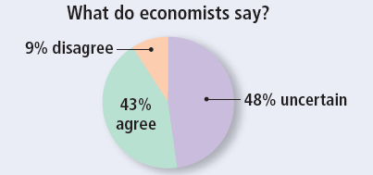
ASK THE EXPERTS, Part 1
The Laffer Curve
“A cut in federal income tax rates in the United States right now would lead to higher national income within five years than without the tax cut.”
Notes:
Source: IGM Economic Experts Panel, June 26, 2012.

Slide 27
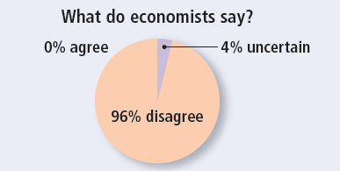
ASK THE EXPERTS, Part 2
The Laffer Curve
“A cut in federal income tax rates in the United States right now would raise taxable income enough so that the annual total tax revenue would be higher within five years than without the tax cut.”

